Slide 1




Data-driven exploration of the carbon emissions impact of grid energy storage deployment and dispatch (DDECEIGESDD?!) Kick off Meeting
24 November 2022

Slide 2
Agenda
0930 | Arrival and coffee
1000 | Welcome DH Aims of the kick-off meeting Brief round table Recap of the project objectives and scope
1030 | Introductions. Each to give 5-10 mins overview Edinburgh TM Imperial MA Oxford DH OCF, National Grid, Pivot Power Introduction to research software engineering (Martin Robinson)
1145 | Break
1200 | Project details and background information Deeper dive on the project aims, background, hypotheses and work plan Existing WeSim model (MA) Existing BEIS study and model (TM/team)
1300 | LUNCH
1400 | Discussions. Facilitated breakout groups PG Is the proposal still ok as it stands? What would we change? What would the first 1-2 outputs/papers/code etc. look like? How to best organise a joint code base and work closely together + the questions posed by everyone in the introductions (above)
1500 | Planning Summarise next steps/actions Review project plan/Gantt chart Decide on who owns each of the key deliverables
1600 | Depart

Slide 3
Aims of today
Getting to know each other
Remembering what the project is about
Review and update the project plans
Discuss and agree how to collaborate as a single team
Define actions for the next 4 months
<Round table>

Slide 4
Why are we here? Overall aim..
Develop tools for determining optimal LOCATION and DISPATCH of grid energy storage.
Two hypotheses to test
Accounting for location-specific (indirect) impacts during dispatch could have carbon emission benefits
Placing storage optimally could accelerate build of renewables
Keep in the back of your mind, though
What do we mean by indirect impacts
What to we mean by “optimally”

Slide 5

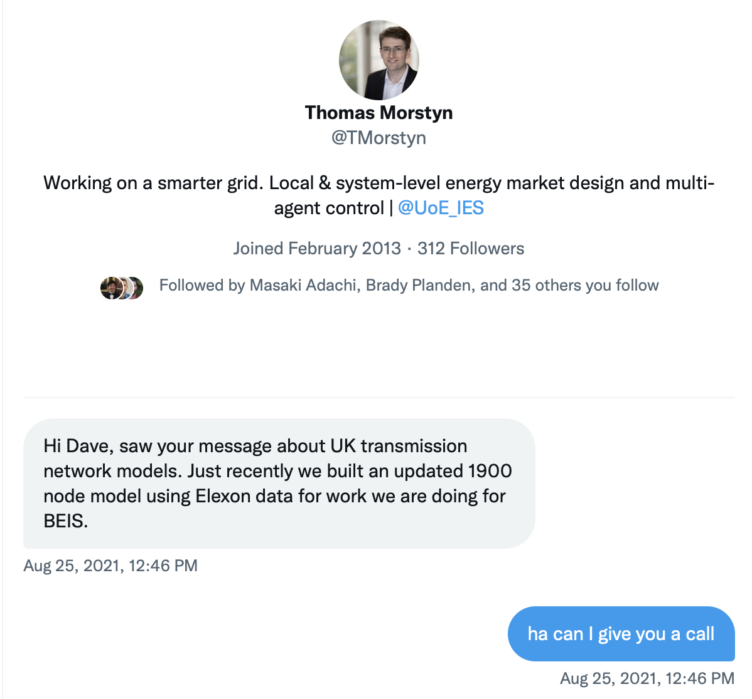
In the beginning…

Slide 6
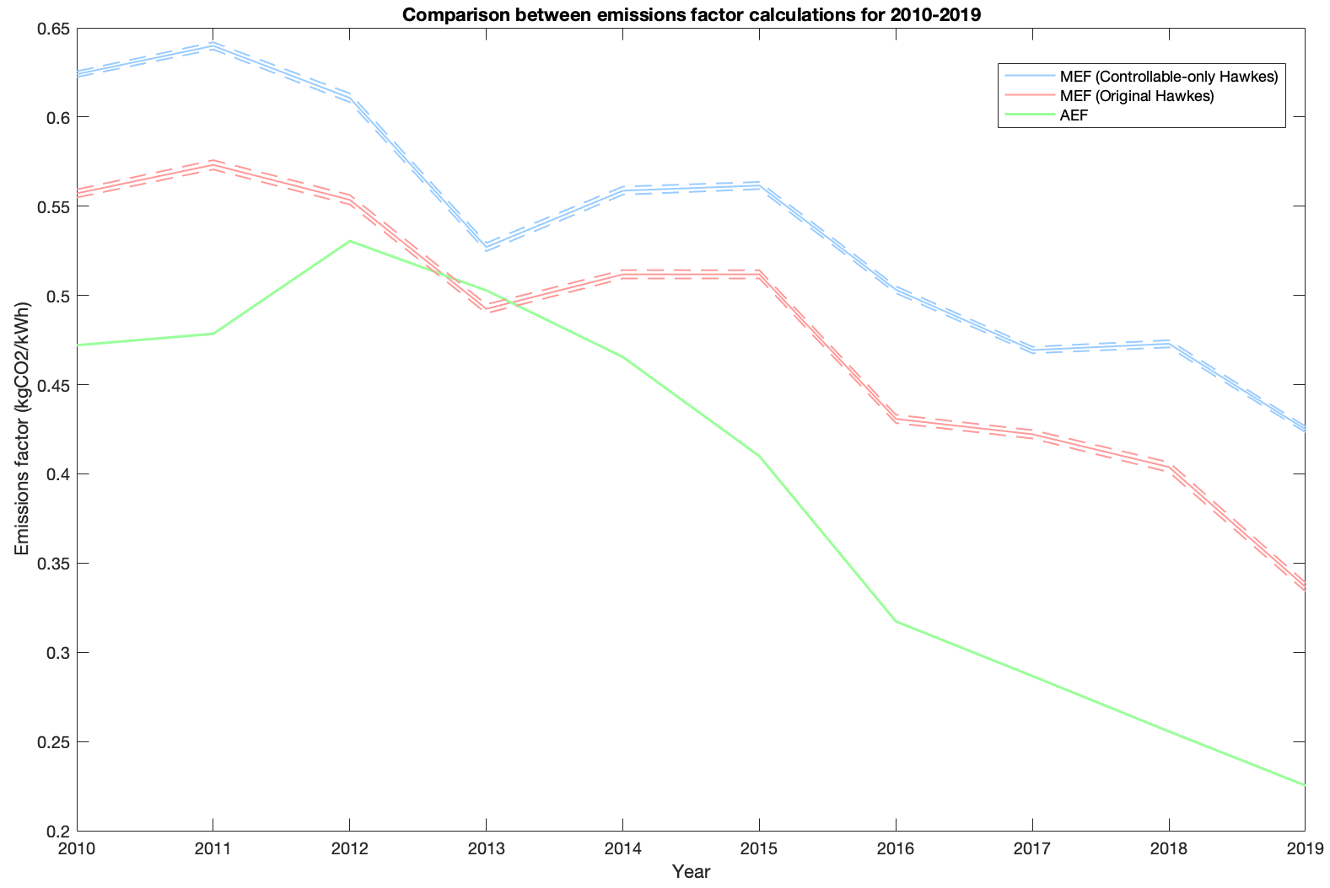
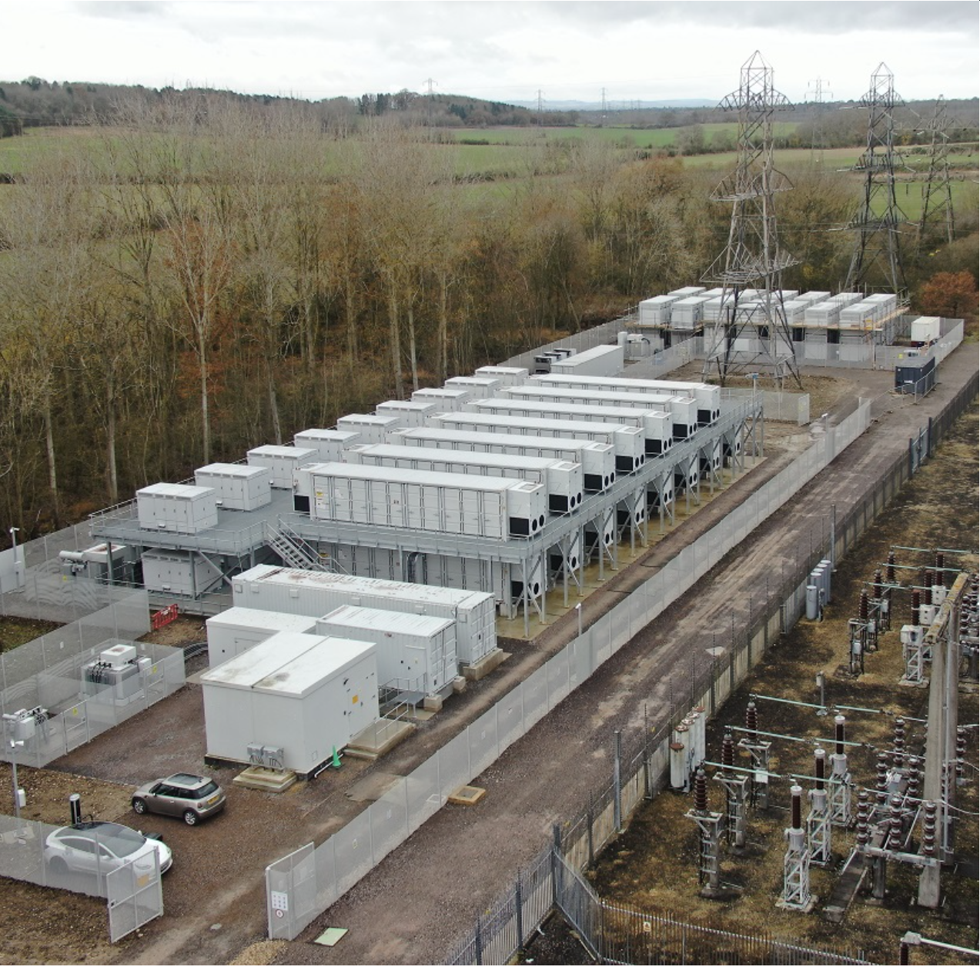

Why is this an issue?

Slide 7
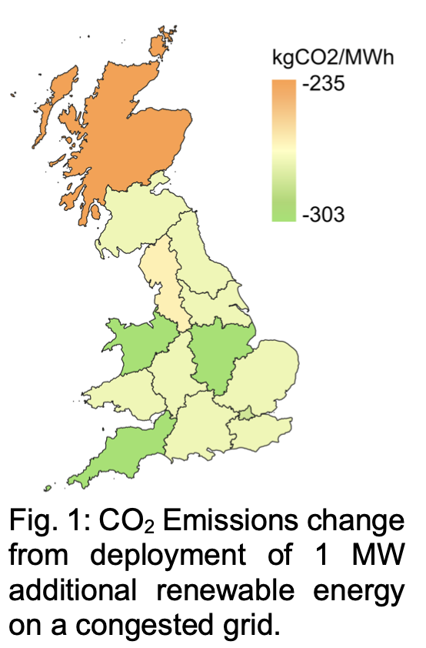
Why is this an issue?
Do the current financial returns for grid ESS in the UK align with the environmental goal of CO2 reduction?
Grid storage might enable CO2 emission reductions (1) by avoiding curtailment of renewables, (2) by removing the need for fossil fuel generators to run part-loaded to provide ancillary services. However we do not yet have a methodology for estimating the impacts. Why? Because we must account for the topology of the network.
GB rebalancing activities already have a locationally-varied impact on CO2 emissions – could be of order 30% difference e.g. between Scotland and SW England due to congestion management, location of renewable generators, etc.

Slide 8
Project objectives
Develop a high-fidelity GB transmission system power flow and market model which can be used to evaluate the direct and indirect carbon impacts of new grid-scale energy storage systems, accounting for technology and location.
Develop scenarios for assessing the carbon reduction potential of energy storage at investment/planning time scales and methods for quantifying the impact of energy storage investment decisions on system-level carbon and financial performance.
Develop new tools for time series modelling and data curation, generation, and management to improve model consistency and to accurately quantify the uncertainty of results.
Complete national scale analysis for the next 15 years and develop a report with policy recommendations for near- and longer-term market reforms.
Integrate the new models into an open-source software toolkit for other researchers, analysts, and policymakers.

Slide 9
10:30 Group Introductions

Slide 10
Introductions
5-10mins overview of each group/org represented, who is involved, what is exciting about the project, some questions for us to think about later
Edinburgh
Imperial
Oxford
OCF
National Grid
(Pivot Power)
Martin Robinson RSE

Slide 11
11:45 Break

Slide 12
12:00 Project details and background information

Slide 13
Project objectives
Develop a high-fidelity GB transmission system power flow and market model which can be used to evaluate the direct and indirect carbon impacts of new grid-scale energy storage systems, accounting for technology and location.
Develop scenarios for assessing the carbon reduction potential of energy storage at investment/planning time scales and methods for quantifying the impact of energy storage investment decisions on system-level carbon and financial performance.
Develop new tools for time series modelling and data curation, generation, and management to improve model consistency and to accurately quantify the uncertainty of results.
Complete national scale analysis for the next 15 years and develop a report with policy recommendations for near- and longer-term market reforms.
Integrate the new models into an open-source software toolkit for other researchers, analysts, and policymakers.

Slide 14
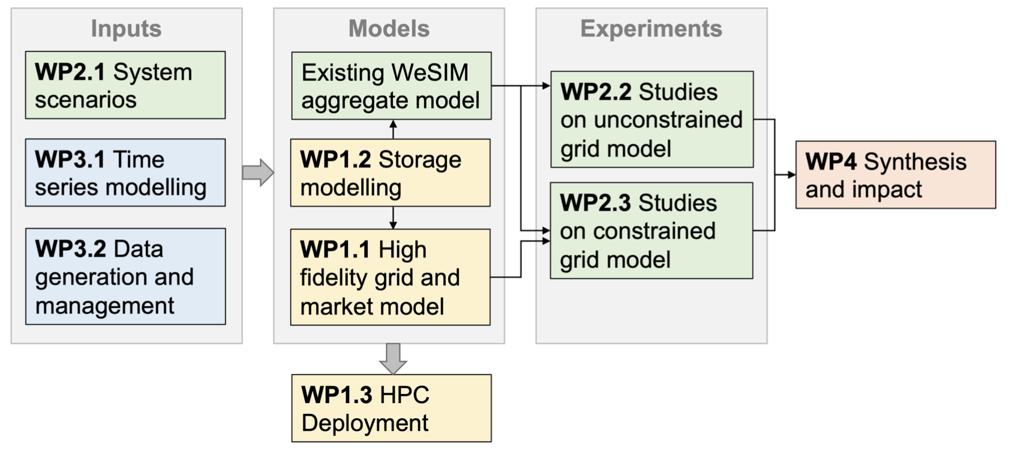
Work packages
Twin aims:
1) Operation (Temporal)
2) Planning (Spatio-temporal)
WP1: Transmission grid and economic dispatch modelling Morstyn Month
1: Grid and market modelling Morstyn, Green 1-15
2: Storage modelling Howey, Green 1-15
3: Model implementation via high performance computing Morstyn 13-18
WP2: Investment planning and scenarios Aunedi
1: System scenarios Aunedi, Green, Morstyn 1-12
2: Carbon impact of energy storage in unconstrained grid Aunedi, Howey 13-24
3: Carbon impact of energy storage in constrained grid Aunedi, Morstyn 13-24
WP3: Data-driven modelling and data management Howey
1: Time-series forecasting Howey, Morstyn 1-15
2: Data curation, generation and management Howey, Aunedi 1-24
WP4: Synthesis and impact Howey, all 1-24

Slide 16
Practical thoughts
Github
Slack
Etc…

